Slide 1
Analysis of Crypto currency Daily Market Data
Presented by:
Kiran Khaniya
Yerbol Panaberdiyev
5/22/2018

Slide 2

Overview: Project 1
A project to perform realtime data analysis using information from XRP cryptocurrency API
Ripple connects banks, payment providers, digital asset exchanges and corporates via RippleNet to provide one frictionless experience to send money globally
Sample data schema:
currency, amount, date time, transaction hash

Slide 3
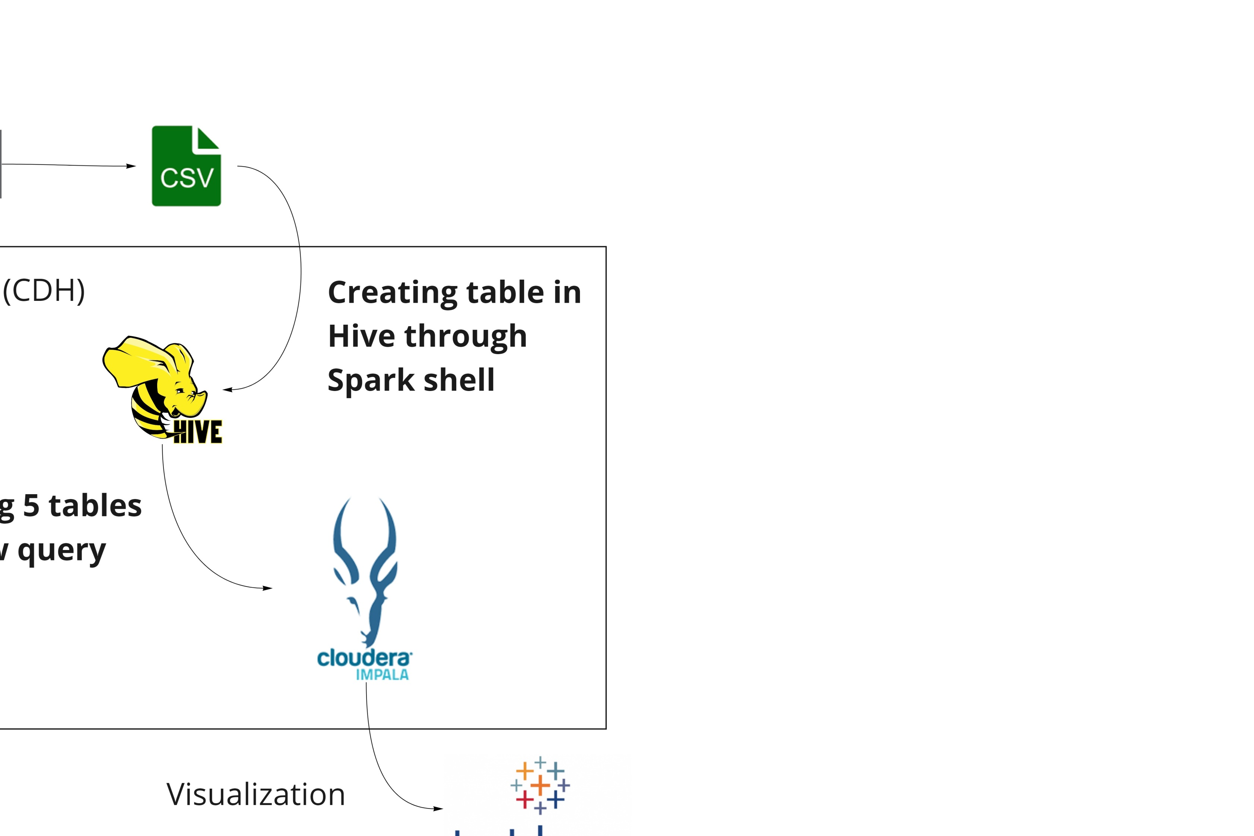
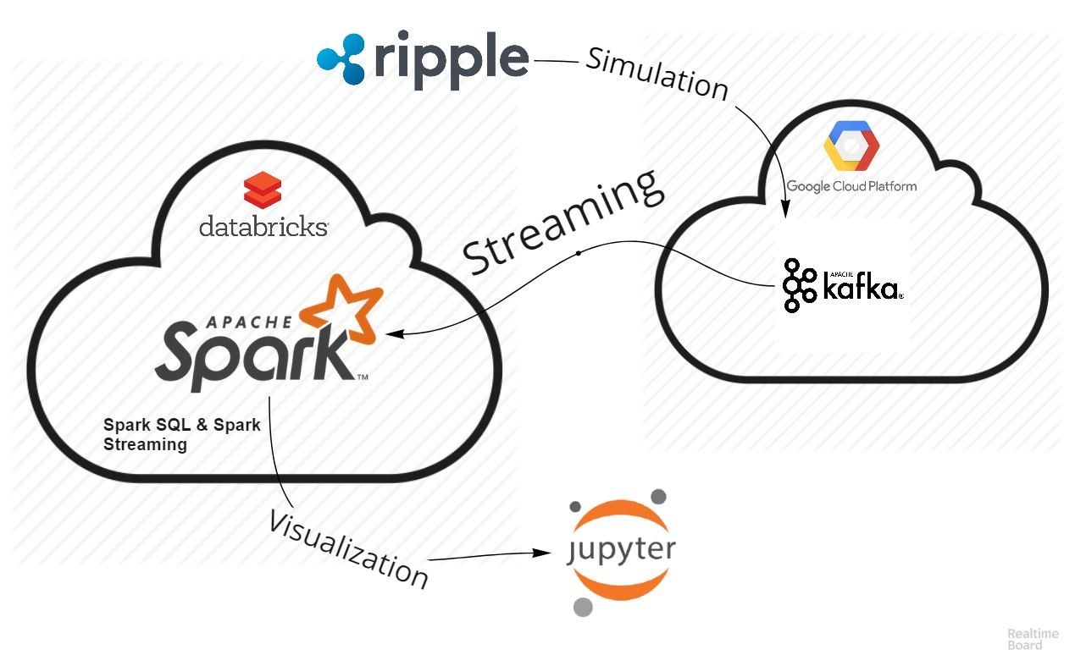
Work Flow

Slide 4
Overview: Project 2
A project to perform data analysis using crypto currency market data from kaggle.
Data from 2013-2018
1587 cryptocurrencies
40MB
Data schema:
name, rank, $ value at open, highest $ value during the day lowest $ value, $ value at closing the day, market value.

Slide 5
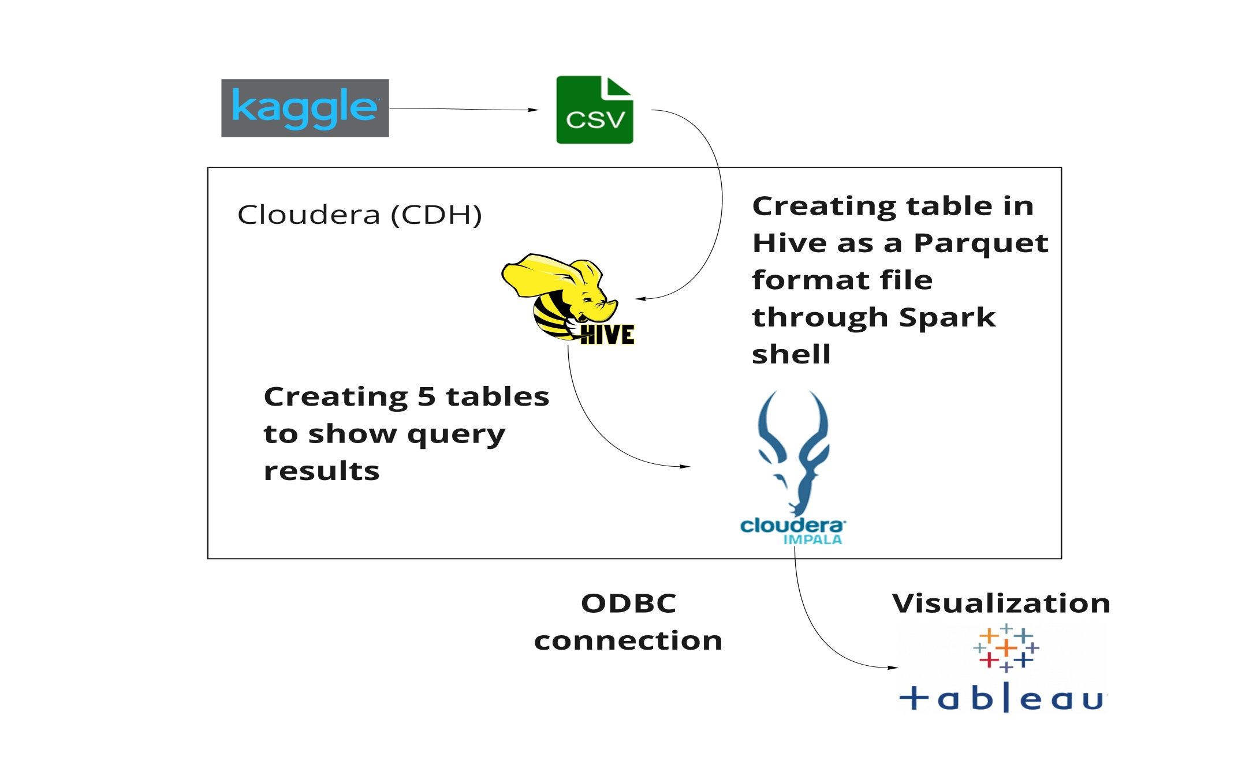
Work Flow

Slide 6
Demo

Slide 7
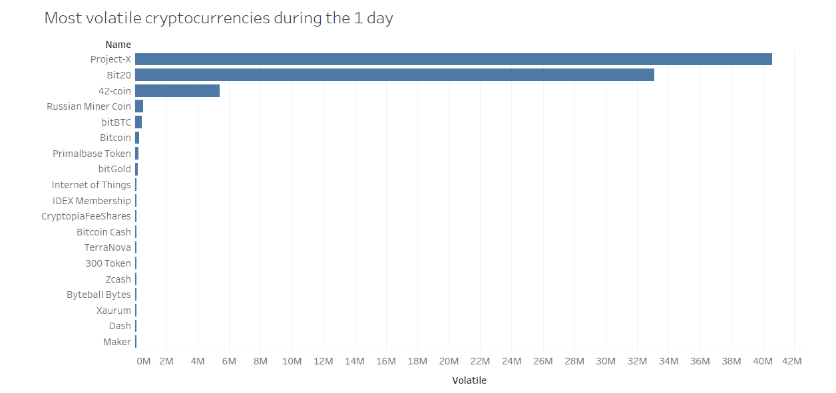
Output graph

Slide 8
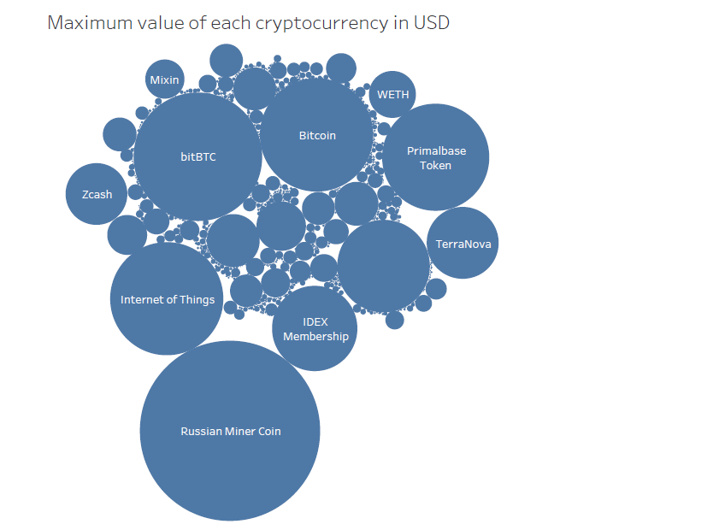
Output graph

Slide 9
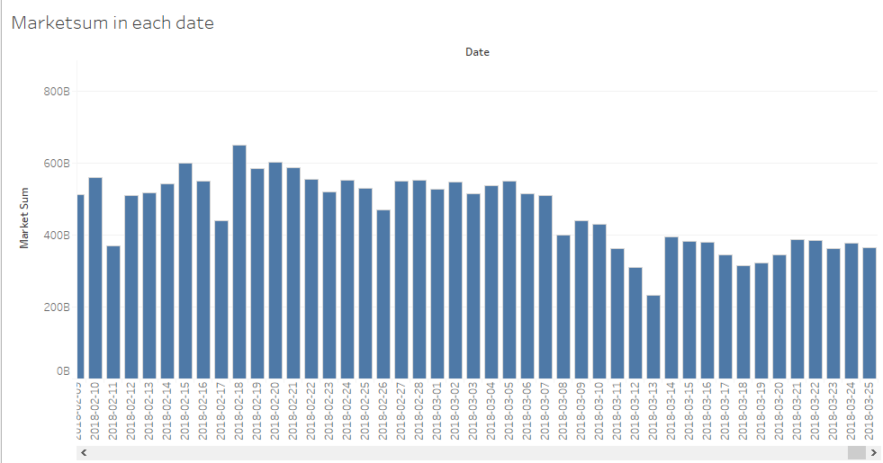
Output graph

Slide 10
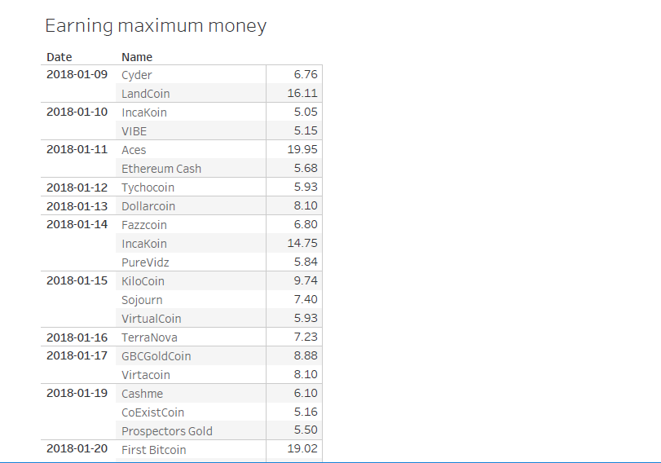
Output graph

Slide 11
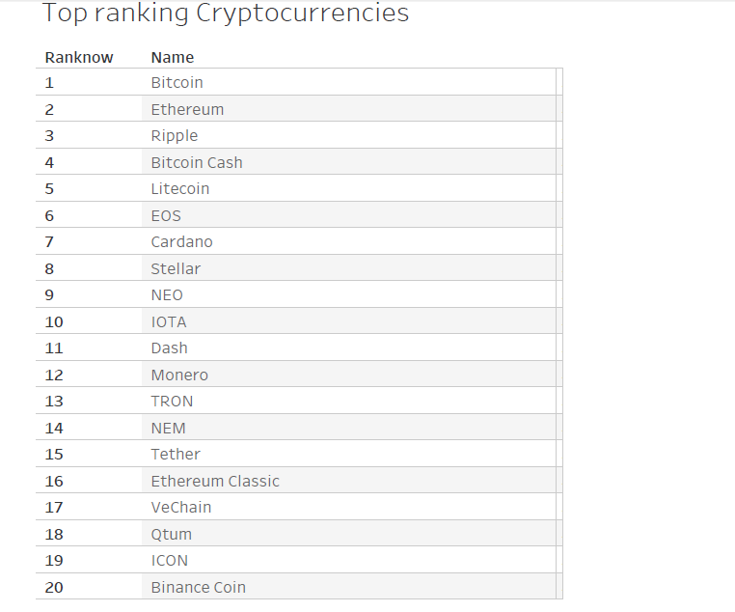
Output graph

Slide 12
Thank you!!

